Slide 1
EE538 Final Project – TrojanMap
Liuliu Chen 12/04/2021
Notes:
Hi, Im Liuliu Chen, Im here to present my final project
<number>

Slide 2
Content
Step1: Autocomplete the Location Name
Step2: Find the Place’s Coordinates in the Map
Step3: Calculate Shortest Path between Two Places
Step4: The Travelling Trojan Problem
Step5: Cycle Detection
Step6: Topological Sort
Step7: Find the K Closest Points
Notes:
So the project contains 7 steps, And I will give some analysis and show some results for each steps.
<number>

Slide 3
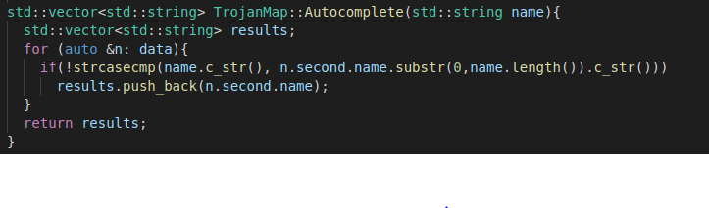
Step1: Autocomplete the Location Name
strcasecmp(str1, str2) : Compares str1 and str2 without sensitivity to case.
time complexity : O(N*m), where m is the length of the name.
Notes:
All alphabetic characters in two strings are converted to lowercase before comparison. ,Return 0 if str1 equals to str2
N is the size of the data, and m should be
<number>

Slide 4
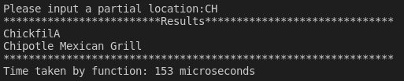
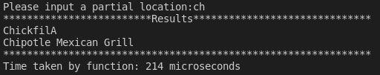
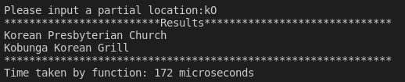
Output:
Case Insensitive!
Notes:
So if we enter the capital or lowercase CH, they will return the same reuslts., therefore they’re case insentive.
<number>

Slide 5
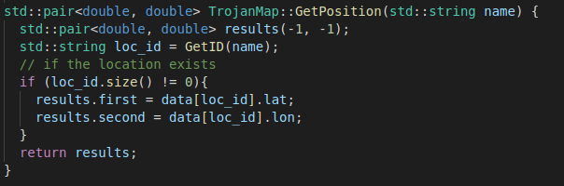
Step2: Find the Place’s Coordinates in the Map
Time Complexity: O(N)
Notes:
Stp2 is to find the place’s coordinate in the map, which is quite straight forward, bc we already knoe the name of the location , and we have the getID function, so we can use this getID function to find the id of this location, then we can get their longtitude and latitude.
<number>

Slide 6
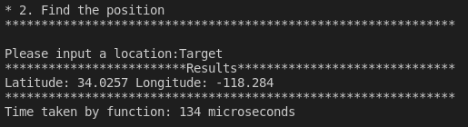
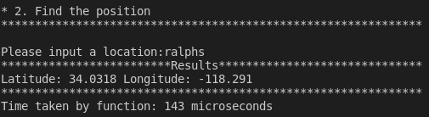
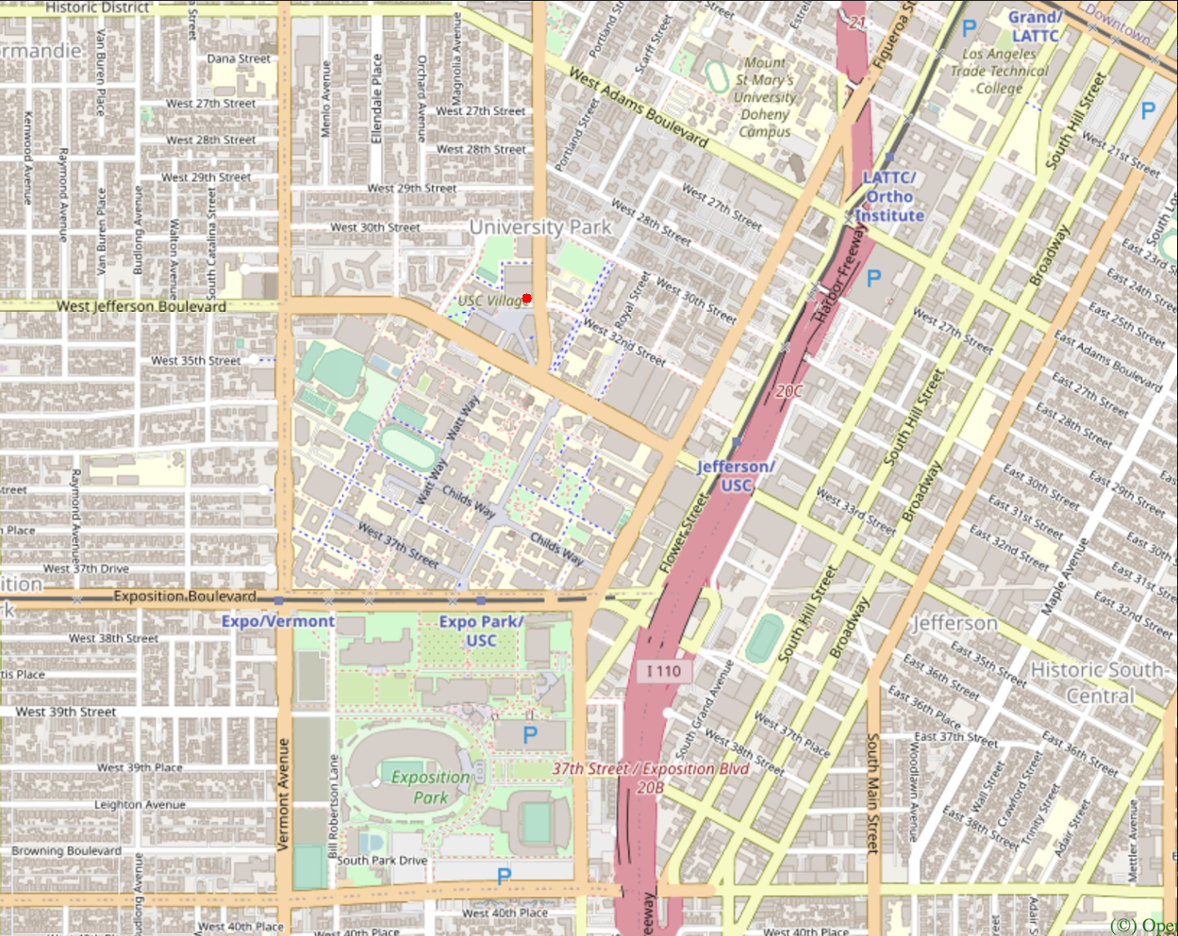
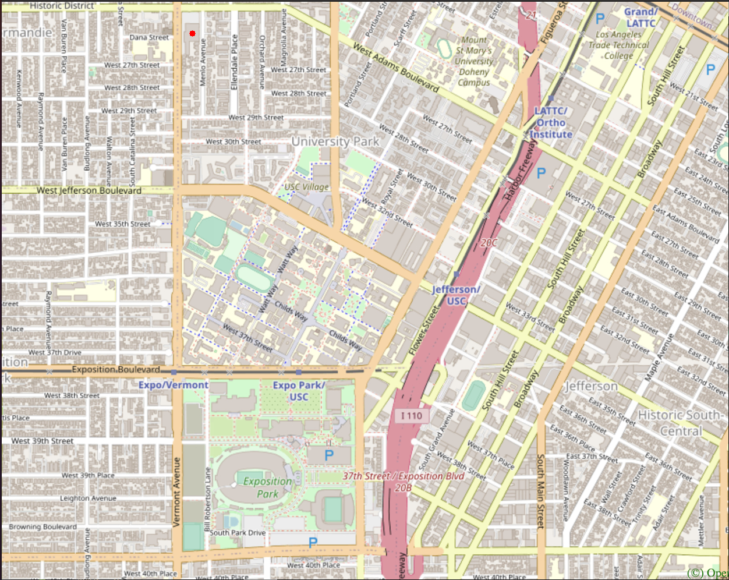
Output:
Target
Ralphs
Notes:
Here’s 2 example , the target and ralphs, we can also plot these location on the map.
<number>

Slide 7
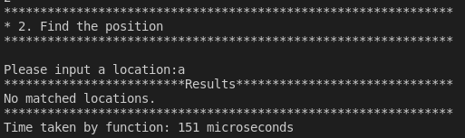
Output:
When the location id does not exists:

Slide 8
Step3: Calculate Shortest Path between Two Places
Dijkstra | Bellman_Ford
Greedy Approach | Dynamic Programming
Doesn’t work when negative weight edges exist. | Works when Negative weight edges exist, and also detect negative weight cycle.
O(E*log(V)) | O(VE)
Notes:
Here we use 2 algorithm, the Dijkstra and the bellman_ford. Here’re some comparison between 2 algorithm
<number>

Slide 9
Runtime Comparison
Source | Destination | Distance | Dijkstra | BellmanFord
CVS | Ralphs | 1.14497 | 15703 | 8403576
Ralphs | Target | 0.839235 | 14421 | 7970619
Sonny Astani School of Civil Engineering | Massman Theatre | 0.0730368 | 15569 | 8443439
USC Parking | Target | 0.291199 | 14978 | 8477145
Metro 40 | CVS | 1.12397 | 15932 | 8540239
Dijkstra is less time consuming.
Notes:
From this graph, we can see when we finding the shortest path from one loc to another, the Dijkstra is always faster than the bellman for
<number>

Slide 10
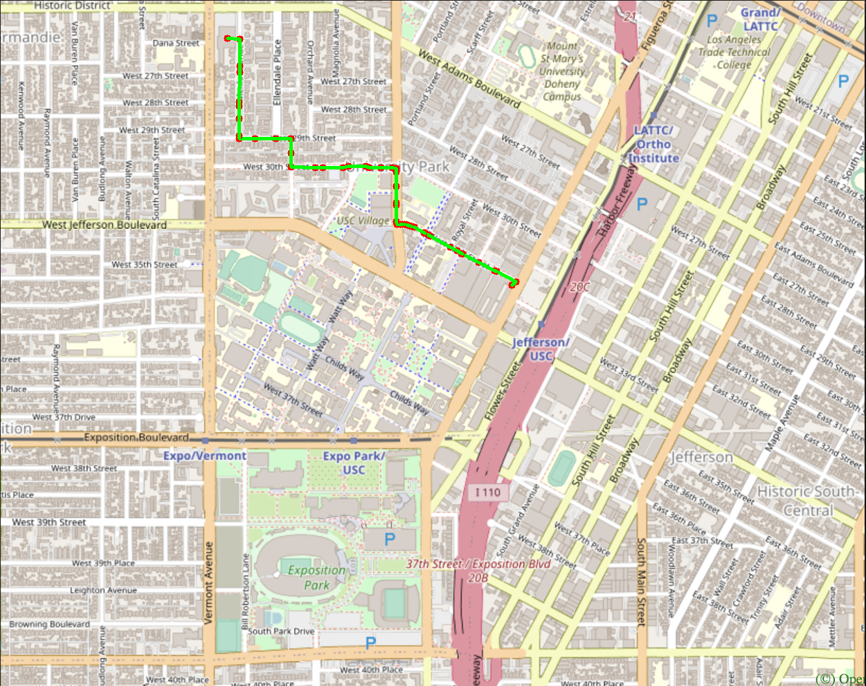
Output:
Ralphs
CVS-Ralphs
CVS

Slide 11
Step4: The Travelling Trojan Problem
 | Backtracking | 2-opt Heuristic
Approach | Take the first node in location_ids as starting and ending point. Staring traversing from the source to its neighbors using DFS. Calculating and updating cost and paths. | Take the location_ids as initial best path. Random choose 2 points i, k between the starting and ending points, reverse the path between i and k. Updating the best path and minimum cost.
Time Complexity | O(N!) | O(N^2)
Notes:
Return 0 if str1 equals to str2
<number>

Slide 12
Runtime Comparison
Numbers of places | Backtracking | 2-opt (MAX_COUNT=5) | 2-opt (MAX_COUNT=30)
4 | 93 | 31 | 83
6 | 2120 | 39 | 120
8 | 50739 | 63 | 174
10 | 1979870 | 76 | 207
12 | 31527610 | 83 | 268
14 | \ | 80 | 353
50 | \ | 375 | 1550
100 | \ | 810 | 3537
200 | \ | 1244 | 5942
Cost time of algorithm (/microseconds)
2-opt is way more faster!
Notes:
It tooks a lot of time for backtracking, so when the numbers of places reaches to 14, it takes more than 5 mins to calculate on my computer, so I just skip the calculation .
For 2 opt-algorithm, I set the max_count to stop iteration, so each time, if there’s no improvement of my new best path, compared to the old one, then do the counting++, until it reach the max_count. Of course, with the larger max_count, the spent time will increase.
<number>

Slide 13
Distance Comparison
Numbers of places | Backtracking | 2-opt (MAX_COUNT=5) | 2-opt (MAX_COUNT=50) | 2-opt (MAX_COUNT=100)
4 | 3.74928 | 3.74928 | 3.74928 | 3.74928
6 | 3.91385 | 4.12016 | 4.06874 | 4.00806
8 | 5.6245 | 8.16689 | 6.10004 | 5.63818
10 | 5.90536 | 8.85507 | 6.10048 | 5.91662
12 | 5.93638 | 9.05072 | 7.22263 | 6.70297
Distances calculated by algorithm (/miles)
Notes:
Here’re the distance comparison, we can find the distance calcupated by 2-opt is larger than the backtracking, so it’s not the optimal solution, but with the max_count increseing, the distance are getting shorter. Considering the runtime of 2-opt, it’s totally acepptable even if we dint find the optimal .
<number>

Slide 14
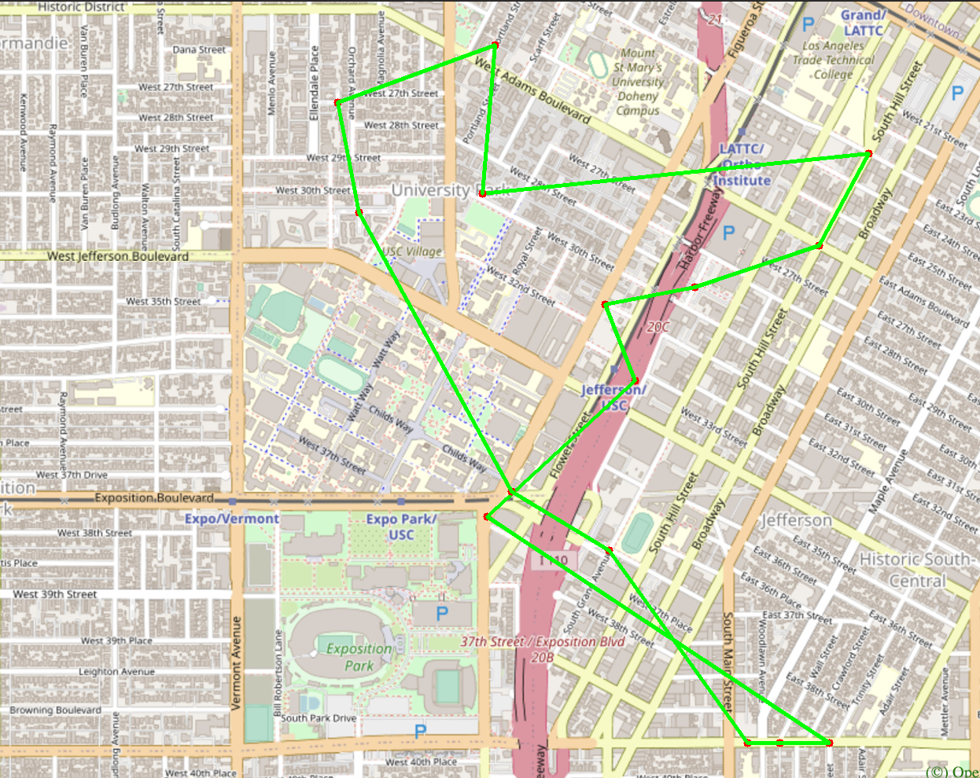
Output:
N=15

Slide 15
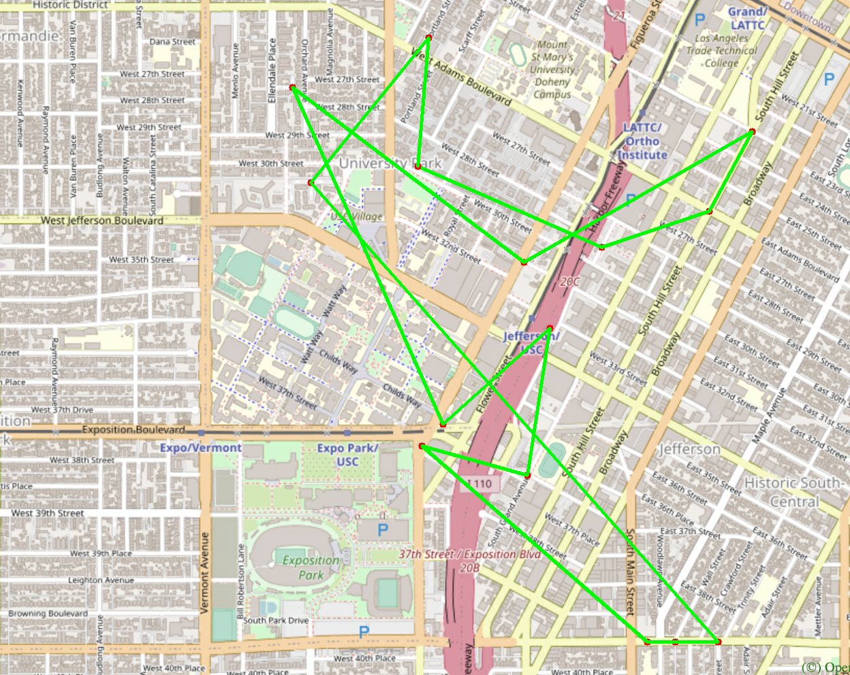
Output:
N=15

Slide 16
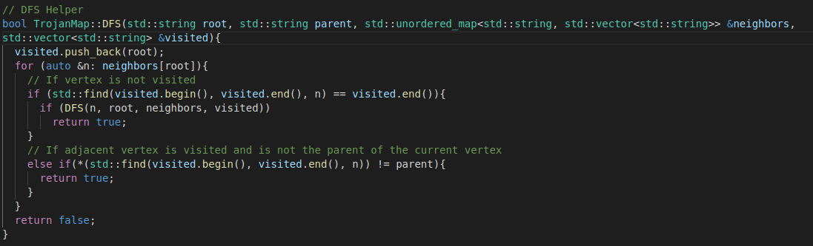
Step5: Cycle Detection
Modification of DFS
Time complexity: O(N+E), where N is the number of nodes, and E is the sum of the sizes of adjacency lists of all nodes.
Notes:
Return 0 if str1 equals to str2
<number>

Slide 17
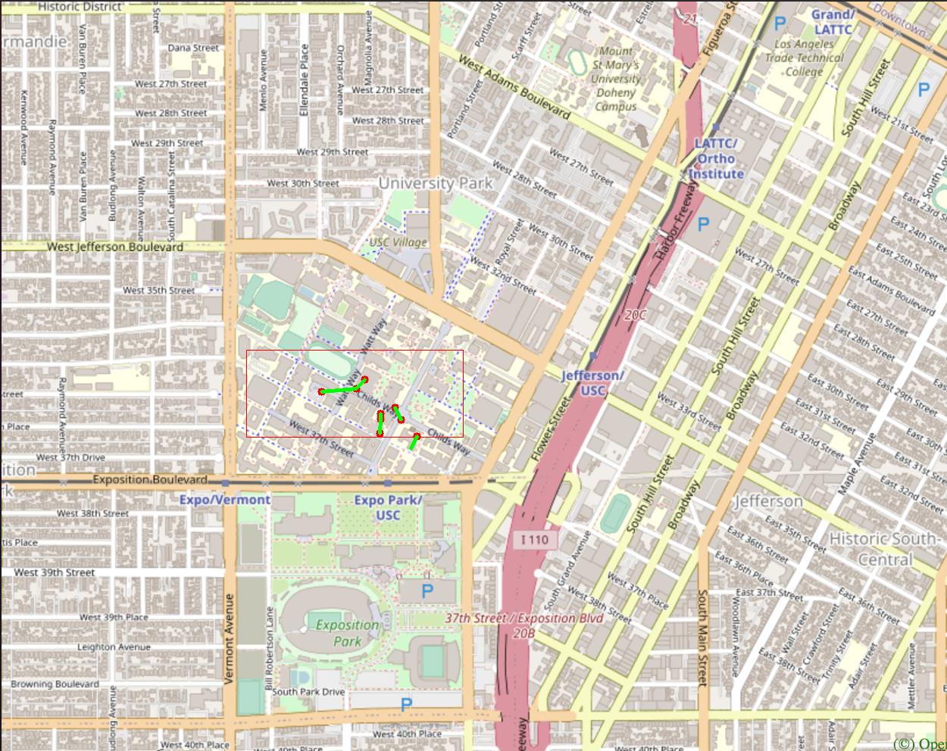
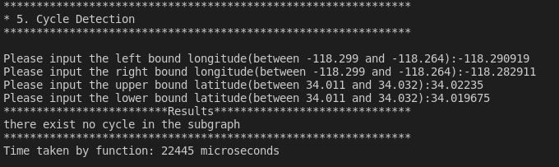
Output:

Slide 18
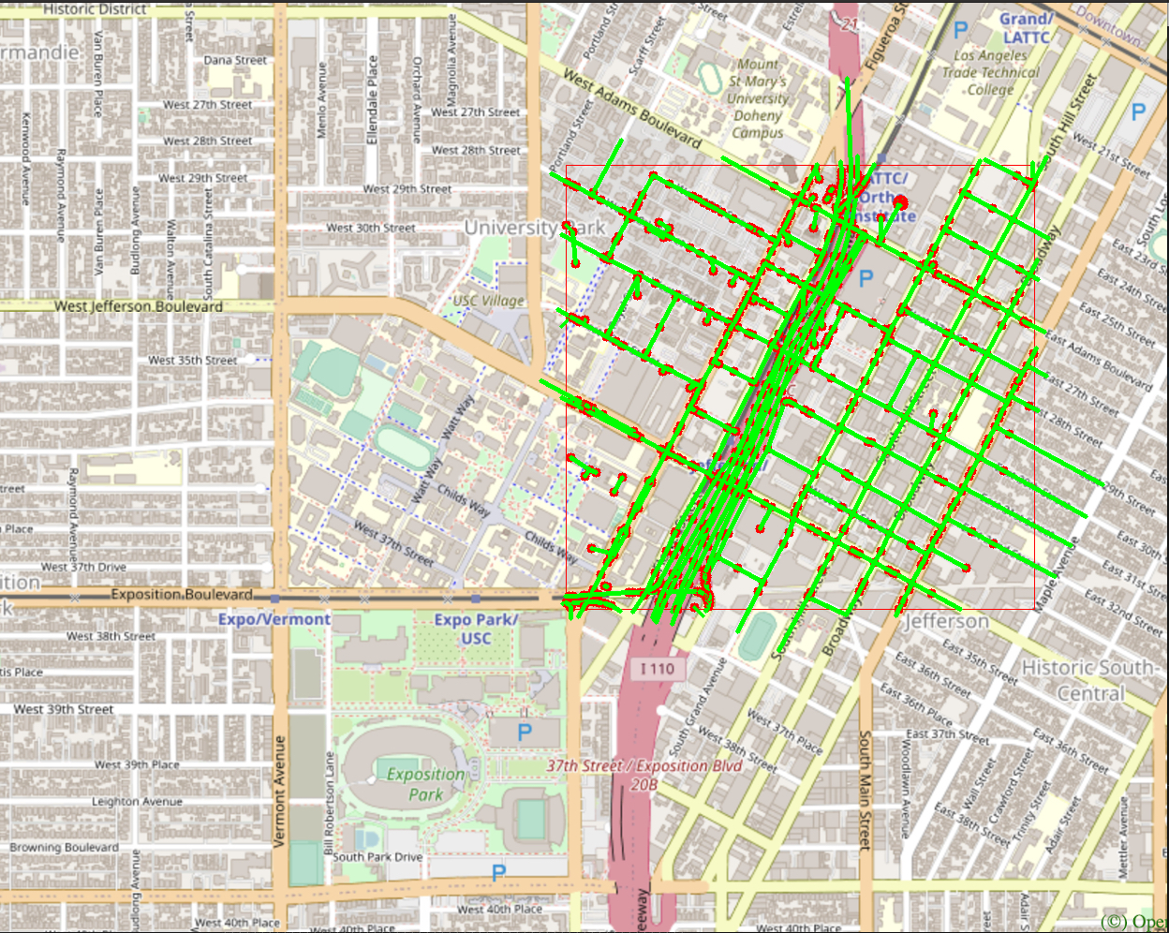
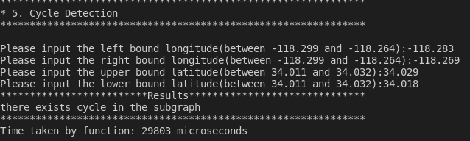
Output:

Slide 19
Step6: Topological Sort
Using DFS
Time complexity should be the same as DFS: O(N+E)
Notes:
Return 0 if str1 equals to str2
<number>

Slide 20
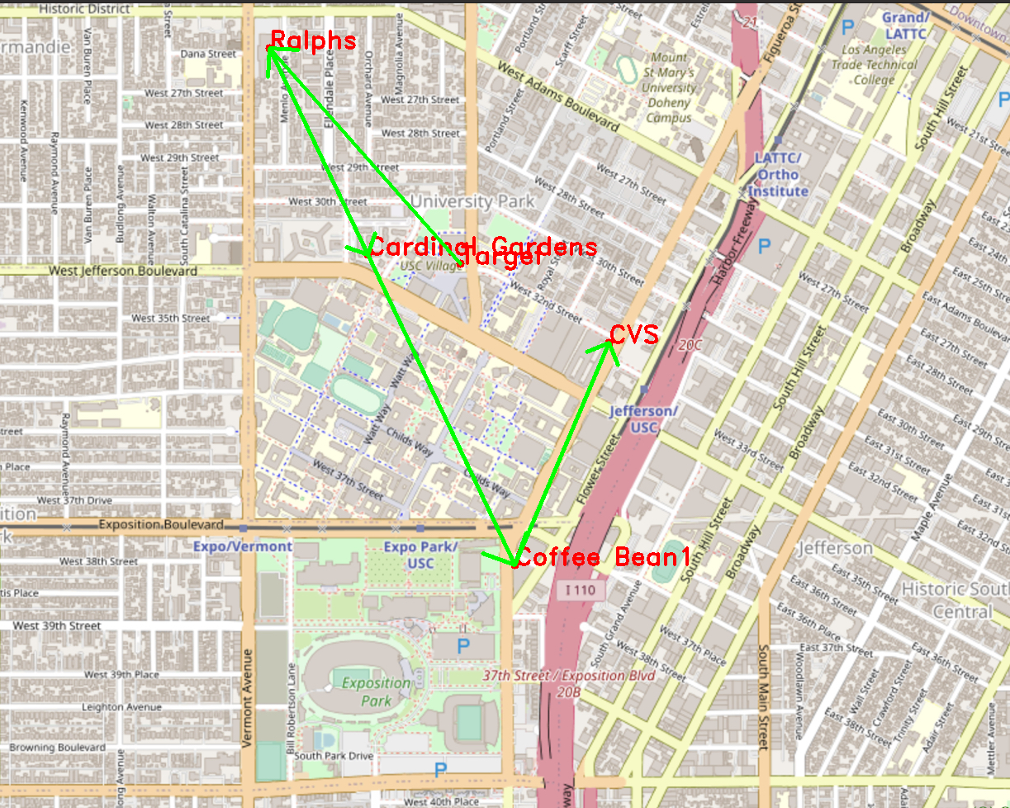
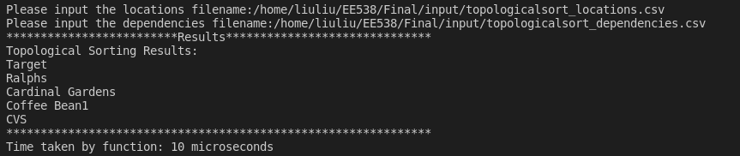
Output:

Slide 21
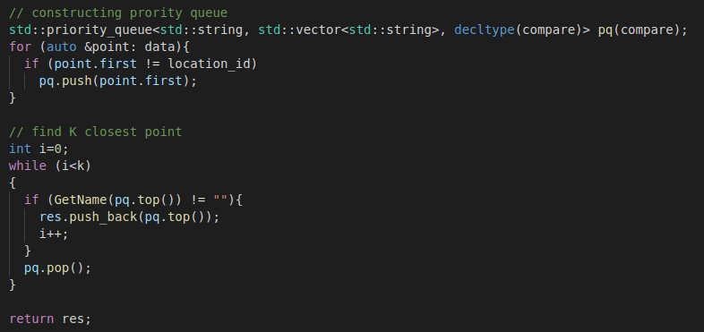
Step7: Find the K Closest Points
Using priority queue
N times
K times
log(N) times
Time complexity: O(N + K*log(N))
Notes:
Initially, I construct a priority queue with the data, which takes n times, so the priority queue garantuee each time I pop the closest node to the source in the queue.
<number>

Slide 22
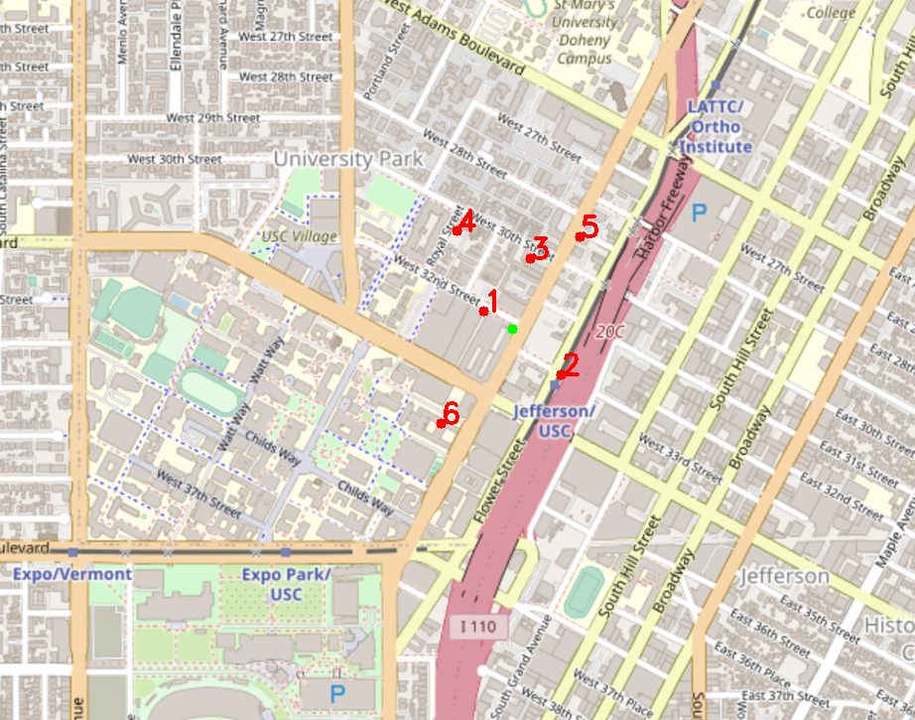
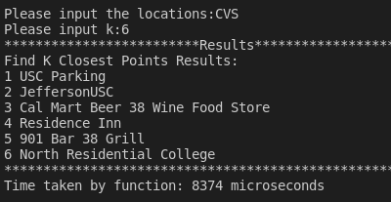
Output:

Slide 23
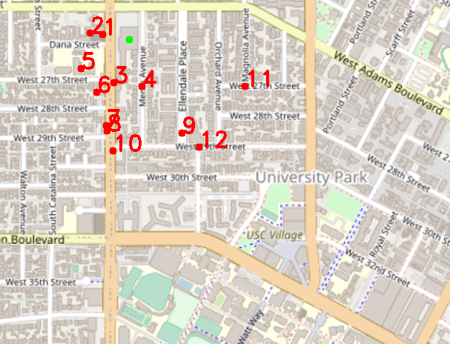
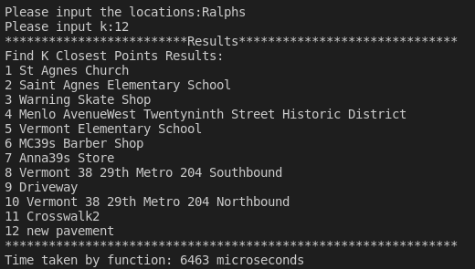
Output:
Notes:
The order of neighbors from 1 to 6, is the same as the last image we see.
<number>

Slide 24
Thank you!

